Slide 1

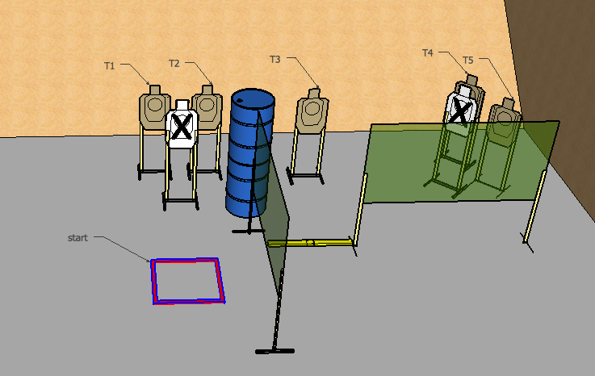
 | Interlake Sporting Association Action Bay, A Stage: Move Then Shoot Or Move And Shoot? Course Designer: Brian Chinn
START POSITION: Standing in start box, loaded and holstered. PCC pointed downrange, stock on belt, barrel parallel with ground.
STAGE PROCEDURE: At start signal, engage T1 and T2 with 3 rounds each. Engage T3-T5 with 2 rounds each. Reload required between first and last shot. |  | STRINGS: 1 SCORING: Unlimited SCORED HITS: Best 2 ROUND COUNT: 12 TARGETS: 5 USPSA, 2 NT START-STOP: Audible - Last shot Muzzle Safe Points: Muzzle safe markers

